Slide 1
Linear Regression
Hamza Al-Habash
ID:19110034

Slide 2
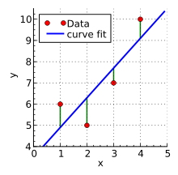
linear regression explanation
A regression is a supervised learning task
We Use the regression to predict a specific actual value.
LINEAR REGRESSION: it’s the task of finding the straight line that best fits the data using
the ERROR FUNCTION which is the difference between the predicted value from the estimated straight line and the actual value of the data

